Slide 1
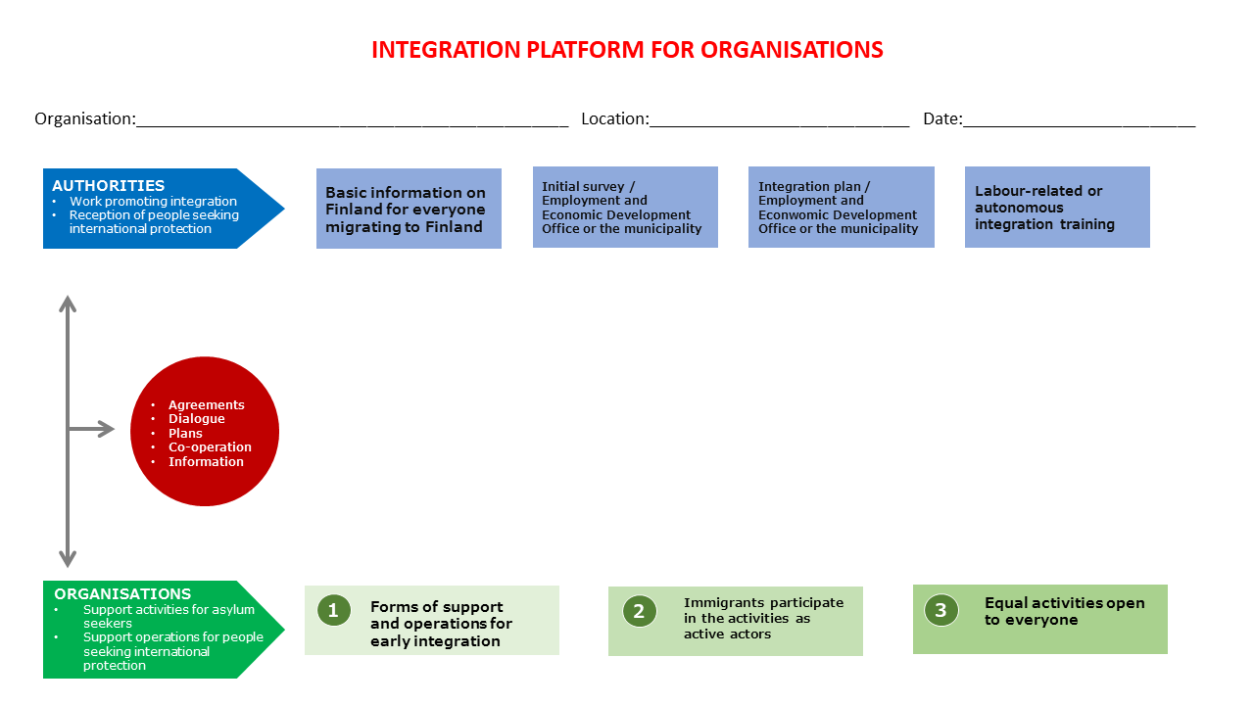
Name of your organisation
Your location
xx.xx.xxxx

Slide 2
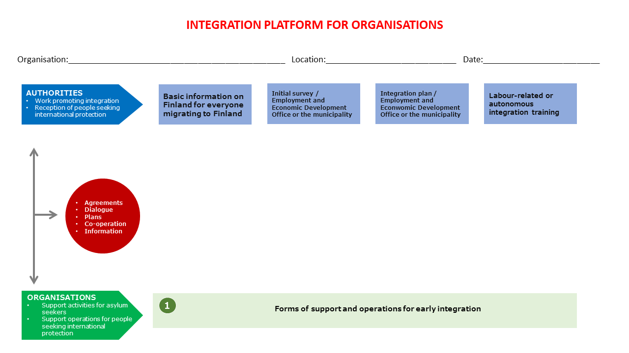
Name of your organisation
Your location
xx.xx.xxxx

Slide 3
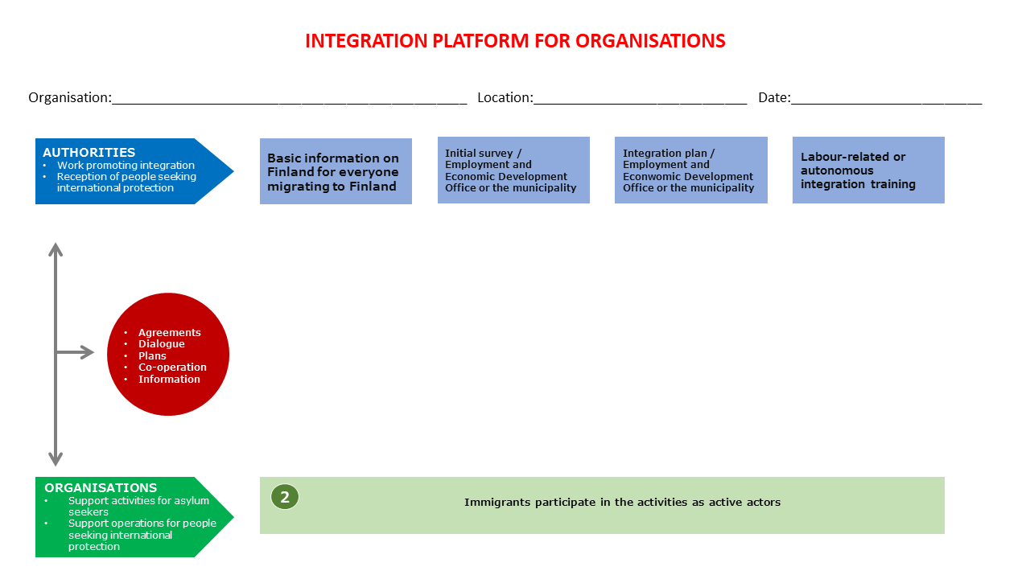
Name of your organisation
Your location
xx.xx.xxxx

Slide 4
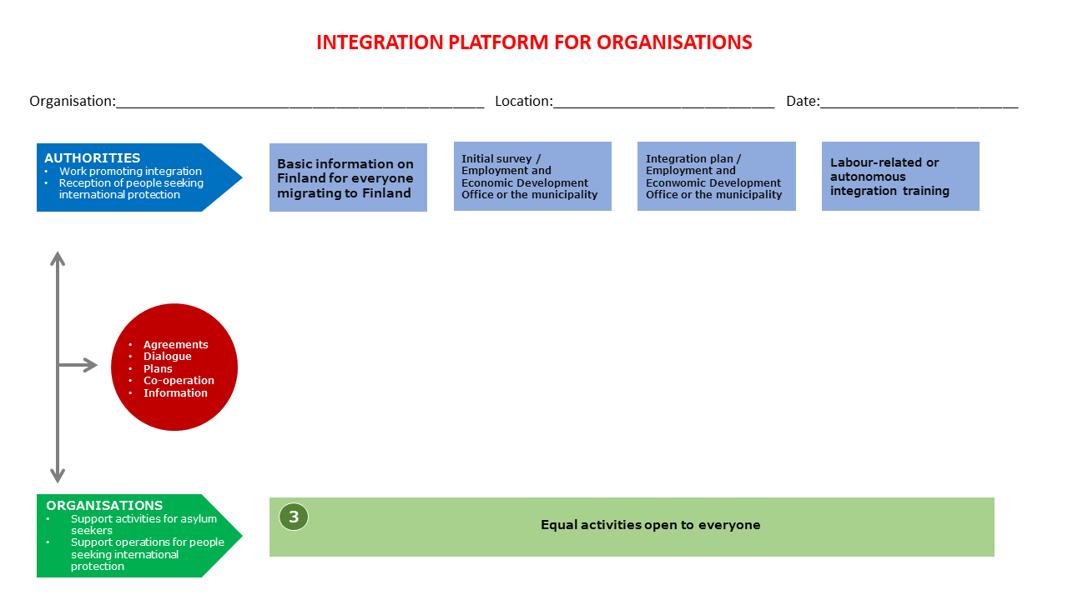
Name of your organisation
Your location
xx.xx.xxxx

Slide 5
Overview of the integration platform
The integration platform has a default template that cannot be edited by the user. This means that the elements and texts in the template cannot be edited, as the template is intended to be the same for all users.
You can find the instructions for filling in the integration platform from the Finnish Red Cross’s Rednet: “integration platform/kotoutumistarjotin” https://rednet.punainenristi.fi/kototarjotin
Adding and editing a text field
You can add a text field in the PowerPoint template by selecting “Insert” from the top of the application and then selecting “Text box” from the toolbar underneath.
Icon for the text box
You can edit the size or place of the text field freely by moving it around with the mouse or by holding the mouse button down on the borders and dragging them.
Adding and editing shapes
You can add various graphic elements or shapes in the PowerPoint template under the same “Insert” menu that allows you to add a text box. These elements can be found under the “Shapes” menu. It allows you to choose between several different shapes that you can also resize and move as you desire, similar to a text box
Shapes icon
You can also write text directly inside a shape without adding a text box on top. Double-click the shape to write inside it.
Printing the integration platform
If you need a printed version of the integration platform you have created, you can print a PowerPoint slide by clicking “File” and then choosing “Print”. The settings menu allows you to choose whether to print only the current slide or all slides. Please note. This instructional slide is hidden, which means that it is not included in the printed slides by default.

