Slide 1
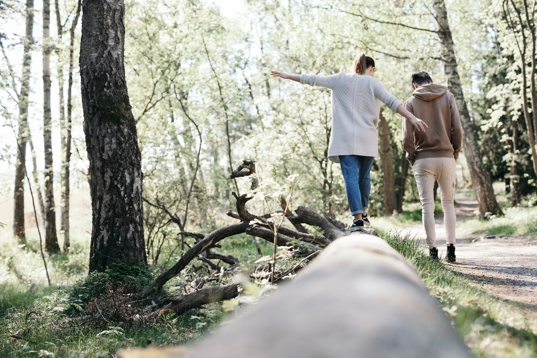
Psychological support – Conflict in Ukraine
Photo: Joonas Brandt

Slide 2

Worry and anxiety
Anyone following the situation in Ukraine can be worried and anxious about the events. Following the news brings us close to military operations, material destruction and even death.
The events can feel strange, confusing or unreal.
It can be difficult to stop thinking about the shocking events and news.
You may worry about the situation escalating geographically and affecting Finland, for example.
The events can particularly affect vulnerable people, such as children, the elderly or people who have moved from war zones to Finland.
People with relatives and acquaintances in Ukraine or Russia or other ties to either country can also react strongly to the situation.
Photo: Joonas Brandt

Slide 3
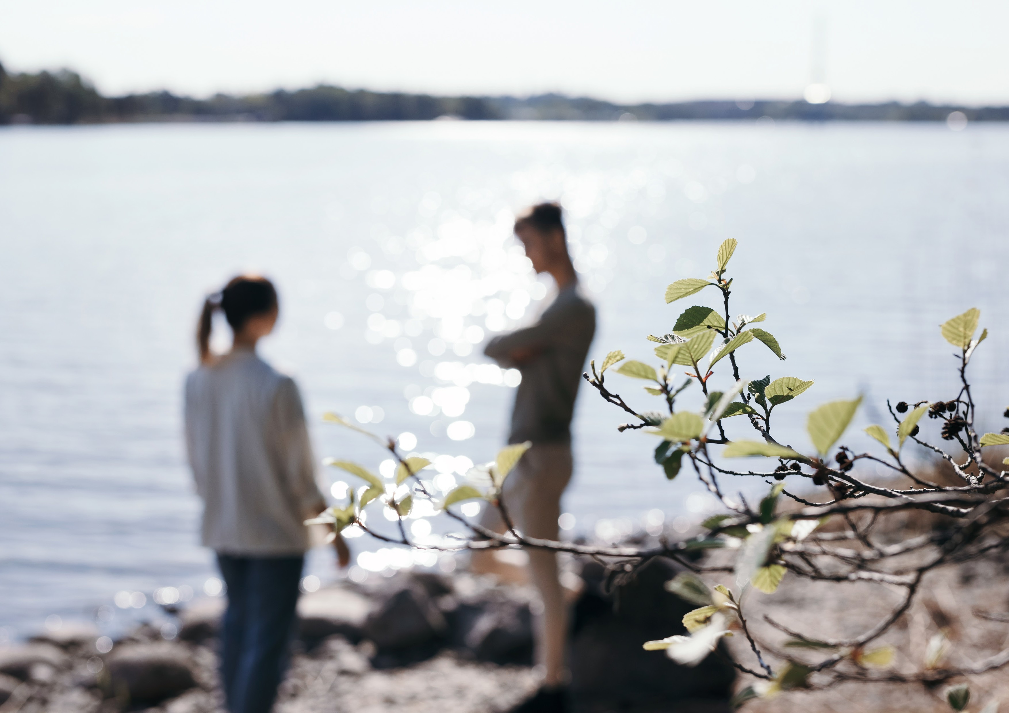

It is natural to react
adaptation
withdrawal numbness
acceptance
overprotectiveness annoyance disbelief
hopelessness
depression
confusion guilt
unreal feeling
aggression
anger
uncertainty about what to do
difficulty to get out of bed
shock
difficulty to carry out daily choresa
fear
trembling
crying
nausea and dizziness
headache
muscle pain and
tension
fatigue
nervousness
stomach pain
sleeping problems
sweating

Slide 4

Mental well-being
Mental well-being impacts, for example, our ability to maintain relationships, care for other people, interact with others, and express our feelings.
Mental well-being also helps us manage occasional anxiety, tolerate loss, and accept changes in life.
A balanced mind can also tell its own thinking and external reality apart.
Photo: Joonas Brandt
Notes:
For the instructor: Why is mental well-being so important?
Text source: FRC: Together, we will feel better https://rednet.punainenristi.fi/node/20466
Five ways to strengthen your mental health:
https://mieli.fi/sites/default/files/materials_files/viisi_tapaa_vahvistaa_-esite.pdf
Help and support with mental health problems:
Municipal health services
School and student health services
Occupational health services
MIELI Mental Health Finland (formerly the Finnish Association for Mental Health). www.mieli.fi
Nyyti ry https://www.nyyti.fi/
Association for Mental Health’s Crisis Helpline https://mieli.fi/fi/tukea-ja-apua/kriisipuhelin-kusteluuaapua-numero-09-2525-0111
Victim Support Finland (RIKU), https://www.riku.fi/en/
AddictionLink helps in various life situations: https://paihdelinkki.fi/en
Health Village https://www.mielenterveystalo.fi/en/
Scientific information: Finnish Institute for Health and Welfare (THL): Mental health: https://thl.fi/en/web/mental-health

Slide 5

Stress has many forms
Everyday stress
Acute stress
Cumulative stress
Burnout
Everyday stress can accumulate
-> Cumulative stress -> Burnout
Eustress
Notes:
Source: Federation’s Guide to Psychological First Aid
Eustress is good stress, a driving force helping you get things done.

Slide 6
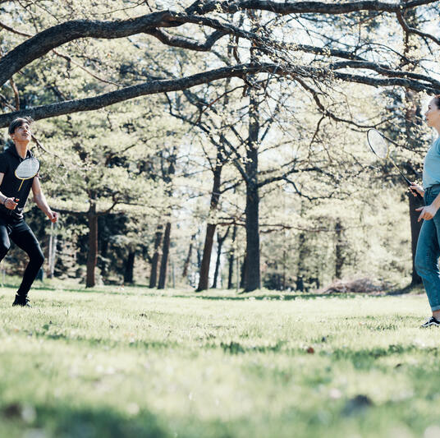
This is how you can help yourself
Talk to others about your experience. Share your thoughts and feelings about current events. Talking helps you process your bad experience.
Stick to your routine and study, work and carry out daily chores as usual.
Exercise is good for you, as it releases tension and calms you down. For example, walking and other light activities will make you feel better.
Avoid excessive amounts of alcohol and sedative substances.
Listen to your loved ones’ feelings and thoughts and share your experiences.
Sometimes it is easier to express your emotions by being active rather than talking. Draw, paint, write, play an instrument or exercise.
Photo: Joonas Brandt

Slide 7
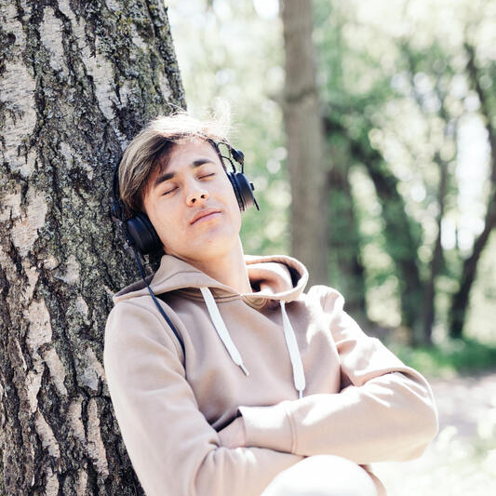
Exercise: anchoring positive things
In this exercise, you anchor a specific positive thing to each finger. In a difficult situation, you can use your fingers to remind yourself of these nice things.
Start the exercise by sitting comfortably on a couch or chair. Raise your hand in front of your face and examine it for a moment. Pick a finger and anchor a specific memory to it (see instructions below). When you have created and connected a happy memory to a certain finger, reinforce the anchored memory by brushing or pressing the anchored finger with your other hand.
Pinky – Think about five things your friends appreciate about you.
Ring finger – Think about a situation in which you have acted bravely.
Middle finger – What things made you happy as a child? What about now?
Forefinger – Think about a nice thing that you hope to happen in a year. What would bring you joy and happiness?
Thumb – Think about five good things about yourself. What do you value about yourself? What are your good characteristics?
Finally, anchor all the things together by clenching your fist and holding your fist with the other hand. Give yourself time to return to this moment in peace.
Photo: Joonas Brandt
Notes:
Source: https://sproppimateriaalit.fi/web/site-185364/state-jurdcmzqhercytzr/page-185449

Slide 8
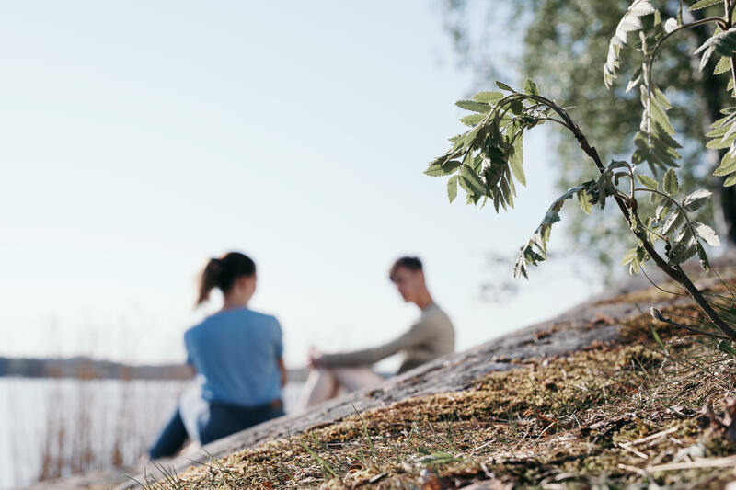
When do you need help from others?
You are constantly anxious, depressed or tense or have uncontrollable emotional outbursts
Constant insomnia or interrupted sleep
You cannot concentrate
You have difficulty in working or studying
You have physical symptoms of stress and anxiety
You are in a constant state of over-excitement
You have no one to talk to
Your relationships suffer and you become isolated
You are constantly or compulsively thinking about what is happening in the world
Seek help from others if you recognise any of these symptoms.
Photo: Joonas Brandt

Slide 9
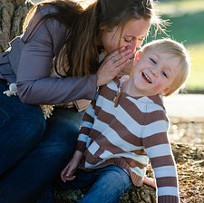
Children need support
Children respond to shocking events and news but they may show their reactions differently than adults.
Even if current affairs are not discussed at home, a child may hear about these topics while playing, in day care or at school. A child may be afraid of “the end of the world” because their friend talked about it at school.
Children's reactions may appear when they play or in everyday activities. The child may also experience symptoms in a seemingly inappropriate manner, even if the initial cause of their unease is fear triggered by the events.
Photo: Pixabay

Slide 10
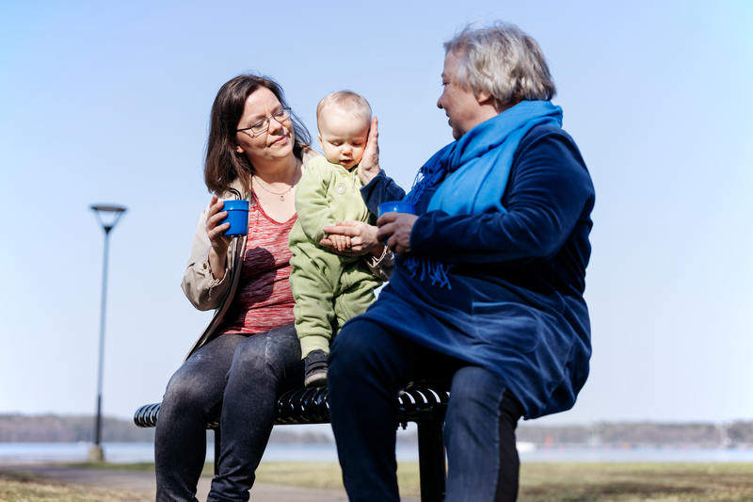
Children are particularly vulnerable to shocking events, because they…
are dependent on the care and security provided by adults
understand situations differently than adults
react differently than adults
have different basic needs (age, gender)
need different kind of support and care than adults
Photo: Joonas Brandt
Notes:
Children react and think differently than adults. They have different needs that are related to their age, stage of development and ability to process information. Their physical size, social dependence and emotional attachment to their guardian impact their position. This course focuses on children's reactions and how to best support them, taking into account their specific needs.
Photo: Pixapay.com

Slide 11
How to support a child
Protect the child from the news and from hearing and seeing the most violent events.
Discuss the situation with the child and encourage them to use their own words.
Encourage the child to express their feelings, for example, by playing or drawing.
Support the child by telling them that the events are taking place far from Finland and that the situation here is stable and peaceful.
Explain that the child's everyday life will continue as normal.
Reinforce the child’s sense of security by maintaining your everyday routines.

Slide 12
Elderly people
There are elderly people in Finland who were children or young when their country was last affected by war.
The current world situation and Russia's involvement in the events may stir up difficult memories and emotions, even fears.
Photo: Joonas Brandt

Slide 13
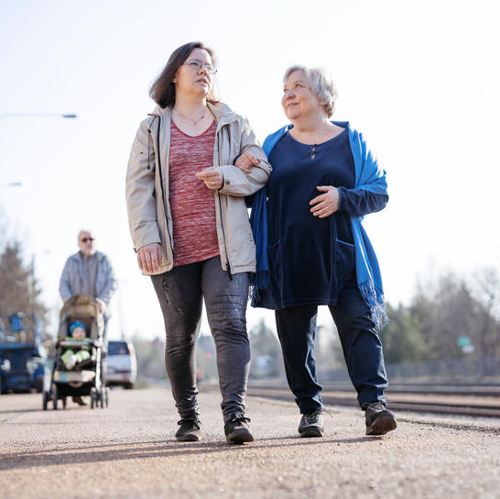
How to support the older generation
Listen to the elderly and encourage them to talk about their feelings if any old memories or experiences come to mind.
Support and soothe the elderly by telling them that the events are taking place far from Finland and that the situation here is stable and peaceful.
Spend time with the elderly and try to make sure that they are not left alone and that their concerns and thoughts are heard.
Photo: Joonas Brandt

Slide 14
Immigrants from conflict regions
How to support a person who has previously been traumatised
There are many people in Finland who have moved here from troubled, even war-torn regions. They may have first-hand experience of challenging life situations, violence and military operations.
Immigrants may relate to refugees and strongly identify with the situation in Ukraine.
Following violent news may bring back old memories and experiences and cause unease and restlessness.
Support the person’s acute sense of security and the fact that life here in Finland is stable and peaceful at the moment.
Limit the use of media and exposure to violence.
Offer an opportunity to talk about and share their experiences.
It is also a good idea to provide special support for the children of immigrant families.

Slide 15

The purpose of psychological support is to promote
sense of safety
calmness
social connectedness
self-efficacy
hope
Photo: Joonas Brandt
Notes:
For the instructor: How to support a sense of safety, calmness, social connectedness, self-efficacy and hope?
Exercise in pairs (10 min+10 min discussion).
How do you reinforce the sense of safety?
How do you soothe/comfort a friend?
How do you promote social connectedness?
How do you support self-efficacy?
How do you create hope?
The instructor writes the answers on a flip chart. How to promote the five principles of Hobfoll:
Sense of safety (e.g. shelter, food, basic necessities)
Calmness (same as above plus correct information about the event, normal reactions, stress management, avoidance of watching event-related news in case of severe anxiety or stress).
Social connectedness (e.g. contacting loved ones, communal activities, recreational activities, religious or spiritual activities, mourning rituals, information on where to get additional help or support when needed).
Self-efficacy (e.g. participation in decision making pertaining to personal affairs, identification and support of own means of coping and strengths, everyday routines (day/night rhythm, eating rhythm, work, study, day care).
Hope (e.g. personal qualities, sense of belonging to a community, belief in the possibility of recovery, close relationships, peer support, professional knowledge and support, participation in recovery activities, spirituality, nature/environment)
For the instructor:
Human survival is supported by:
Safe and peaceful environment
Positive and health-enhancing everyday activities
Experience of communal support
Confidence in own resilience and resources
Positive thinking and beliefs, such as religious or spiritual beliefs
Ability to maintain normal routines and return to them quickly
Psychological First Aid Guide for National Red Cross and Red Crescent Societies. https://rednet.punainenristi.fi/henkinentuki

Slide 16
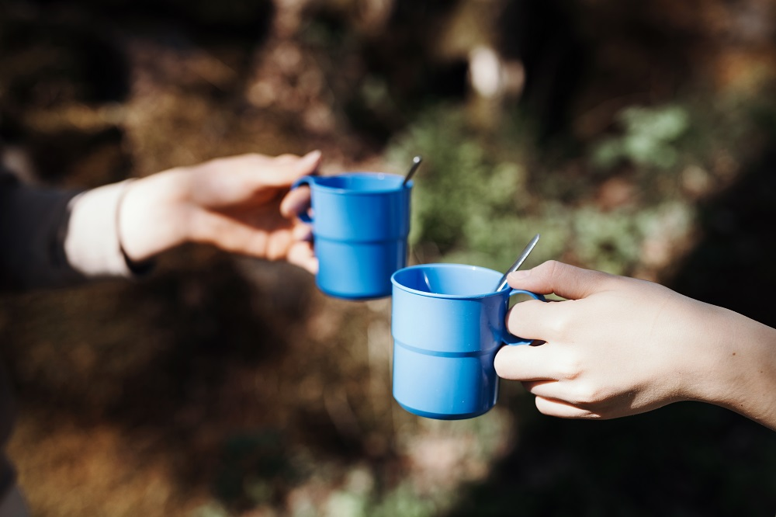
The need for support varies from one person to another
Beliefs related to life management, security, trust, power, social relationships and independence may change as a result of a crisis.
The need for support cannot be inferred from the event itself or whom it affects. The crucial thing is how an individual reacts to the event. The need for support varies from one person to another.
Photo: Joonas Brandt
Notes:
For the instructor:
Not everyone reacts to crises at the same time or in the same way.
Not everyone needs or wants psychological first aid.
A scary event can also have a strong impact on onlookers who have witnessed it and they may need psychological first aid.
Some remain calm and do not react strongly at the time of the incident, but react strongly later.
Some react strongly, but do not need psychological first aid, because they are able to process the situation themselves or receive support from elsewhere.
Extra exercise: If the schedule is not tight, you can do this exercise. An exercise on beliefs, for example, in three groups: 10 min+10 min discussion.
Safety
When do you feel safe? Why?
When do you feel unsafe? Why?
Which factors can increase your sense of safety?
Which factors have influenced your idea of safety?
Trust
In pairs, discuss what trust means to you.
When can you trust something? Why?
When can you not trust something? Why?
How can you increase your sense of trust?
Which factors have influenced your idea of trust?
Life management
What does life management mean to you?
When do you feel that you are/are not in control of your life? Why?
Which factors have influenced your views?
Psychological First Aid Guide for National Red Cross and Red Crescent Societies. https://rednet.punainenristi.fi/henkinentuki

Slide 17
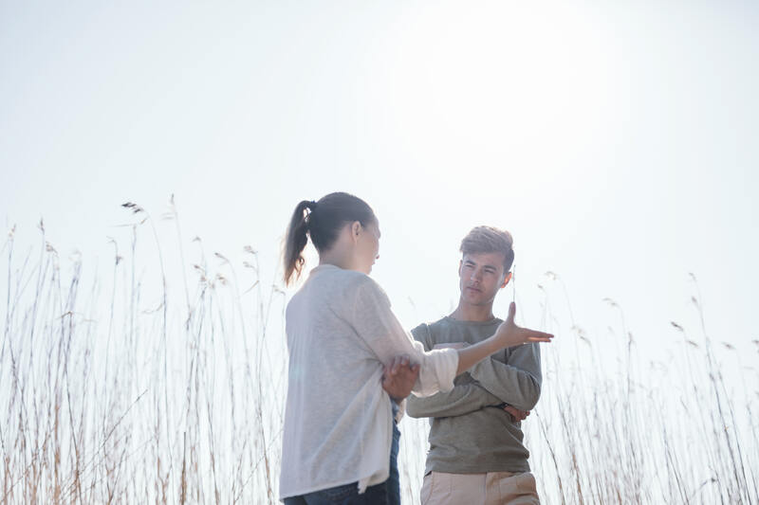
Active listening
Give some room for conversation. The responses can be
spontaneous. The important thing is to share your thoughts and feelings.
Everyday routines and a regular daily rhythm help you cope. Regular meal times, rest and exercise help.
Support the person's own resources.
If the person is grieving, let them grieve the past.
Photo: Joonas Brandt
Notes:
Photo: Pixapay.com
For the instructor:
We are all different – children, adults and elderly people. So be yourself. Understanding and accepting difference is the starting point for successful interactions
Think about the topics for discussion and seize the moment and the issues/themes discussed. Be natural and talk about things that you both can talk about (e.g. weather).
You do not have to be a nurse, just someone that the person can rely on, who talks/chats with them and helps with small things.
Make eye contact when you speak. You can even hold the person’s hand. Listen and “read” the person. Expressions and gestures tell a lot about a person's health and condition.
If possible, find out the main disease of the person you are helping, so that you can “read” the person a little better.
Be calm and clear (but try not to be too loud). Long sentences can be confusing.
A patient with dementia can live in another reality, which is fine as long as it does not distress them.
If a disabled elderly person complains/tells you about symptoms that you think are serious, contact the friend agency. The customer may have, for example, a heart disease, asthma, etc., that requires treatment.
When helping a person, avoid
giving them advice
questioning the person’s feelings
comforting – phrases
talking about yourself
bragging
lecturing
storytelling
digging up the past
correcting the person
the hero complex
moralising

Slide 18
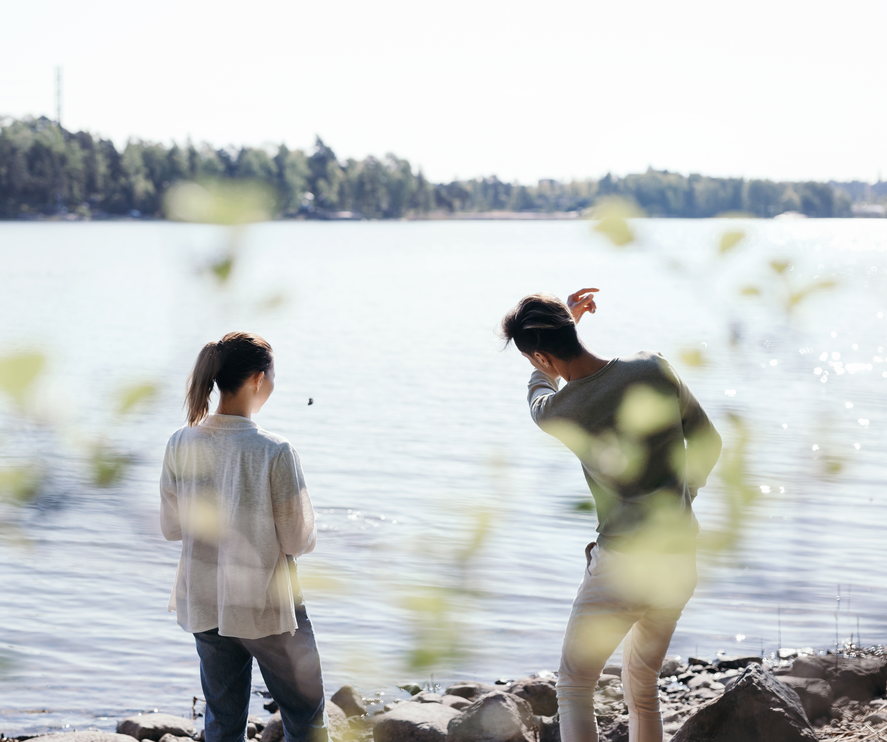
Active listening
Eye contact
Open questions
Further questions
Listen more than talk
Repeat in your own words
Do not interpret
Do not interrupt
Do not judge
Summary
Photo: Joonas Brandt
Notes:
Extra exercise: If the schedule is not tight, you can do this exercise. Exercise (before showing the slide): Think about a situation where you have received help from others? What helped you in the situation? Think about the questions alone for a little while, then discuss in pairs and finally together, total 15 min.
You can also do an exercise on tolerating silence.
Stay quiet for a minute in pairs. How did it feel? Did you feel like laughing? Did the time feel long, uncomfortable, etc.?
More information: prcentre.org – Caring for volunteers
Presence: creating a sense of safety, building trust, calmness creates serenity
Accepting your emotions: no judgment, no interpretation, empathy
Active listening (gestures and postures): open body language (e.g. do not stand with your arms crossed, appropriate distance, eye contact, etc.), open questions, calmness, no “why” questions ->easily interpreted as blaming.
Empathy: Try to understand the other person's life situation and thoughts. Treat them with respect and as your equal.
Authenticity: Be yourself! If you do not know or cannot comment on something, be honest.
Give room: Focus on what the other person is saying to you, what they think and feel. Give room to the other person's negative feelings, pain, confusion, grief and anger. Also, make room for silence and learn to tolerate it.
Ask open questions: Avoid questions that can only be answered “yes” or “no”. Open questions begin with “how”, “when”, “where”, “who”? Encourage discussion by asking questions and making comments. Look the person in the eyes.
Useful questions for the listener:
Do you feel...? Do you mean that...?
I don't really understand what you're talking about...
Would you tell me...? Could you tell me more?
That reminds me...
Have you thought about...? How does that make you feel?
Is there anything else you can think of? Can you think of any examples?
When did you feel that way? Do you feel like that right now?
What do you mean?
Did I understand correctly that...? Is it the case that...?

Slide 19
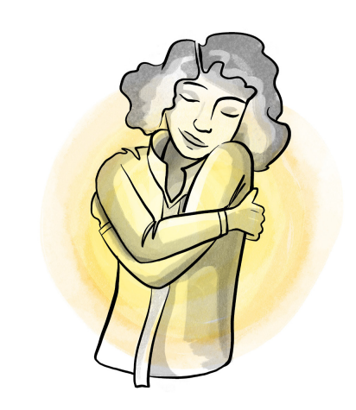
Calming yourself down: butterfly hug
When you feel stressed, you can take a few minutes to calm yourself down. You can do the butterfly hug while standing or sitting.
  Keep your feet firmly on the ground. Feel the support against your feet.
  Take a deep breath.
  Give yourself a big hug for a few seconds.
  Loosen your grip for a second and repeat a couple of times.
  You can also tap your arms with your fingertips while hugging yourself.
Notes:
https://hepsy.fi/2018/05/17/perhoshalaus/
https://pscentre.org/wp-content/uploads/2022/02/The-Well-being-Guide-Reduce-stress-recharge-and-build-inner-resilience.pdf

Slide 20
How can I help Ukrainians?
The Finnish Red Cross Disaster Relief Fund helps victims of conflicts and natural disasters all over the world. The funds in the Disaster Relief Fund are uncommitted money, which we can use to help the Ukrainians if necessary. You can donate to the Disaster Relief Fund here: https://www.redcross.fi/donate/disaster-relief-fund/
In Ukraine, the Red Cross’ assistance is provided by the Ukrainian Red Cross, the International Committee of the Red Cross and the International Federation of Red Cross and Red Crescent Societies. The Finnish Red Cross has also helped in Ukraine for years. The Finnish Red Cross is monitoring the situation closely and is ready to provide additional assistance from the Disaster Relief Fund when necessary.
The conflict has damaged civilian infrastructure (e.g. water supply) and undermined the sense of safety.
You cannot donate clothes to Ukrainians through the Finnish Red Cross. The Ukrainian Red Cross and the International Red Cross handle material assistance centrally on the conflict site.

Slide 21
How does the Finnish Red Cross help in Ukraine?
The Finnish Red Cross has for years provided support for the victims of the conflict in Ukraine through the International Red Cross.
The International Red Cross provides assistance on both sides of the line. It helps secure people's basic needs. The Red Cross provides water, food, shelter and health services. It also helps in the search for missing persons.

Slide 22

Where to get help if you are running out of strength and cannot cope on your own?
Municipal social and healthcare services
Occupational health services
School and student health services
Organisations
  MIELI Mental Health Finland
    Crisis Helpline
    Crisis Centre
    Sekasin chat
    Peer support groups
  Mannerheim League for Child Welfare
  Save the Children
  Finnish Red Cross Youth Emergency Shelters
Tukinet.net – one-to-one and group support online
  Support in different life situations provided by several organisations. https://tukinet.net/
  Ukrainan sota ja mielenhyvinvointi (War in Ukraine and psychological well-being): https://www.ninalyytinen.fi/psykopodiaa/ukrainan-sota-mielen-hyvinointi
Photo: Pixabay

